Slide 1
Career-track Faculty Promotion Workshop
Patricia Friedrich, Vice Provost for Academic Personnel

Slide 2
Timing
Criteria
Process
{
Agenda

Slide 3
Part I: Promotion Timing; when should I go up?

Slide 4
Asst. Teach. Prof. → Assc. Teach. Prof. Clinical Asst. Prof. → Clin. Assc. Prof. Research Asst. Prof. → Res. Assc. Prof.
All things being equal, you should have 5 years at an entry-level rank before going up for promotion to the associate level.

Slide 5
Assc. Teach. Prof. → Teaching Professor Clinical Assc. Prof. → Clinical Professor Research Assc. Prof. → Research Professor
For a promotion from associate to full, you should have a minimum of 7 years overall, and you should have a sustained record of excellence since your last promotion.

Slide 6
Title changes may delay promotion
Case Study: Matilda was an assistant teaching professor for 2 years at ASU; then she accepted a clinical assistant professor appointment in the same unit. She’s had 5 years at ASU, and is now wondering if she should go up for promotion.
Issues to consider:
If her previous job was exactly the same, then why did her title change from assistant teaching professor to clinical assistant professor? The assumption is that a title change means a change in job duties.
If her previous duties were considerably different, she probably needs more time to establish excellence in her role.
→ Matilda should probably take at least 2 more years to establish excellence in her current role before going up.

Slide 7
Time at ASU is important.
How good are you at teaching ASU students in ASU programs, for example?

Slide 8
Consider carefully the question “Why go up now?”
Since career-track faculty don’t have mandatory review dates, they should wait until they have clearly established excellence before deciding to go forward with a promotion package.

Slide 9
Part II: Promotion Criteria; how will my performance be measured?

Slide 10
Faculty Promotion/Academic Affairs Manual 506-05
Review for Promotion: Fixed-Term Faculty
Individuals with fixed-term faculty appointments as lecturer*, clinical faculty, and research faculty are eligible for promotion in rank. The promotion review for fixed-term faculty is designed to ensure a fair and impartial process that is clear, unambiguous, comprehensive, and applied consistently and uniformly. The review is conducted in the following order, assuming each level exists: academic unit personnel committee, chair/director, college committee, supervising dean, and provost of the university. The provost of the university makes the final decision for promotion.
*Lecturer titles will soon change to teaching professor titles in ACD Manual

Slide 11
Faculty Promotion/Academic Affairs Manual 506-05
Review for Promotion: Fixed-Term Faculty, continued
Due to the differences in types of work performed by persons in fixed term appointments, academic units must clearly define the criteria for promotion to each rank. For information about university promotion review requirements for academic unit bylaws, see P22, “Fixed-Term Faculty Promotion and Renewal Requirements for Academic Unit Bylaws.” For information about promotion file content requirements, see P6, “Fixed-Term Faculty Promotion Process Guide.” The date when promotion files are due in the Office of the Provost of the University is specified annually in the schedule of personnel actions released by the Office of the Provost of the University.

Slide 12
Academic Professional Promotion/ACD 507-07
Academic professionals are promoted based on proven excellence in position effectiveness; professional contributions; and institutional, professional, and community service. Excellence is achieved in the context of the program in which the academic professional works. (…)
This process is conducted in the following order: the library or academic unit personnel review committee, the library or academic unit administrator, the college peer review committee, the college dean/university librarian, the University Promotion and Continuing Appointment Committee, the provost of the university, and the president.

Slide 13
Tip: before you decide to go up, ask your unit for a copy of your rank’s criteria for promotion
Example criteria for a promotion to associate teaching professor:
Candidate has a terminal degree.
Candidate demonstrates evidence of 5 years of successful teaching.
Candidate has developed a curriculum in the area of specialization.
If research and creativity is part of the assignment, candidate has achieved a program which is attracting regional attention.
If service is part of the assignment, some service to the school and the university is expected.

Slide 14
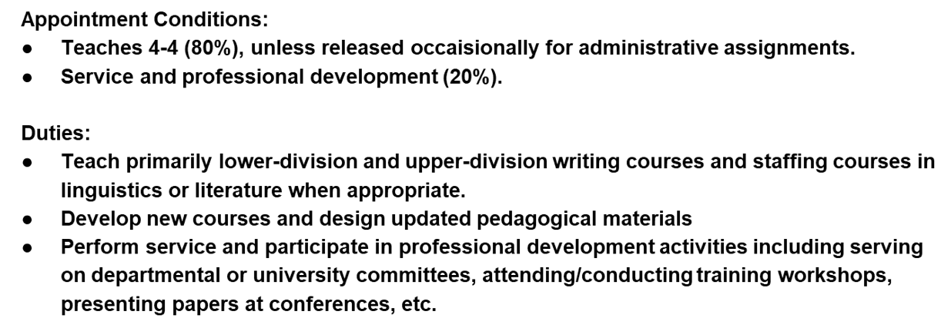
Tip: also ask your unit for a copy of your job description
Example assistant teaching professor job description:
Jobs change over time. Your job description should describe the job you are currently performing. If not, speak to your director.

Slide 15
Part III: Process Guide for Fixed-term* Faculty Promotions; what are my action items?
*Process guide language will soon change from “fixed-term to career-track”

Slide 16
Process Guide for Promotion of Fixed-term Faculty
Please note that excerpts from the process guide in this PowerPoint presentation may change or may be abbreviated. The most current version of the Process Guide for Fixed-term Faculty Promotions can always be found at:
https://provost.asu.edu/academic-personnel/personnel-processes

Slide 17
Process Guide for Promotion of Fixed-term Faculty
Candidate Responsibilities
Step 1. Submission of materials.
Candidate checks with unit chair/director to determine the unit’s submission deadlines for the following materials. According to the unit deadline, candidate submits electronic copies (PDF) of the following to the unit: a. CV. A full and comprehensive curriculum vitae with page numbers and candidate’s name on each page.
Pay strict attention to the formating requirements

Slide 18
Tips re CVs
Make sure your CV is accurate; otherwise doubt is cast upon all of your case materials.
Make sure your CV is clear and easy to read.
If applicable, include annotations, impact factors, and conference presentations.

Slide 19
Process Guide for Promotion of Fixed-term Faculty
Step 1. Submission of materials, continued.
b. Personal statement. A personal statement up to four pages in length, single spaced, 12 pt. font with page numbers and candidate name on each page. The personal statement provides reviewers with evidence of excellence in teaching, research, and service as applicable to the candidate’s area(s) of assignment as articulated in the job description for the candidate; and how the candidate’s teaching, research, and service activities (as applicable) have built the foundation for continued professional growth.
Pay strict attention to the formating requirements

Slide 20
Tips re personal statements
Use your personal statement to make your case, not to repeat your CV.
What’s important? What’s exciting? This should be in your personal statement.
Use your personal statement as a link to the job description and the criteria for promotion.
Explain how your materials add up to merit promotion.

Slide 21
Process Guide for Promotion of Fixed-term Faculty
Step 1. Submission of materials, continued.
c. Research and scholarship. Any candidate whose job description includes an expectation of research/scholarship shall also submit publications/creative materials as follows:
i. Candidate completes the Confirmation of Publications/Creative Materials Selections by listing four publication titles or descriptions of creative activity reflecting his/her research, scholarship and/or creative activities; include citation information as applicable and PDF page numbers on the form.

Slide 22
Process Guide for Promotion of Fixed-term Faculty
Step 1. Submission of materials, continued. c. Research and scholarship, continued.
ii. Candidate provides unit with electronic copies of publications/creative materials identified on the
Confirmation of Publications/Creative Materials Selections. If applicable, submit one copy of the CD or
DVD of copyrighted material which cannot be scanned (e.g. music, film, etc.).
iii. Candidate signs and submits Confirmation of Publications/Creative Materials Selections to the unit.
Include a blank page with a note if there are no publications/creative materials.

Slide 23
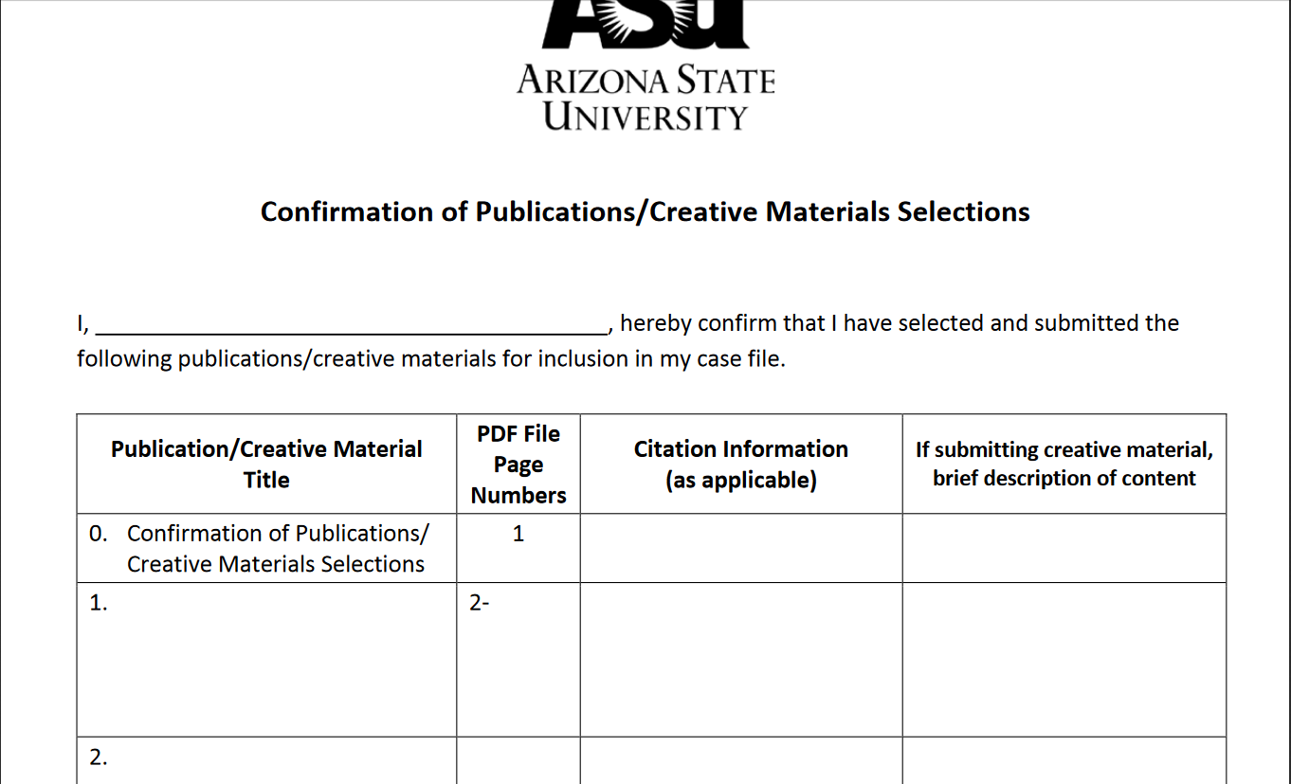
Confirmation of Publications/Creative Materials Selections
This is where you list your publications. You must sign this form.

Slide 24
Tips re publications
If you include copies of research materials, ideally, these will be papers that were produced while at ASU.

Slide 25
Process Guide for Promotion of Fixed-term Faculty
Step 1. Submission of materials, continued.
d. Evidence of excellence in teaching and mentoring. Any candidate whose position description includes an expectation of teaching shall include evidence of excellence in teaching and mentoring. These materials are in addition to the Summary of Student Evaluation of Instruction provided by the unit, and are included in the Teaching Evidence section. Candidates should work with their unit chair/director to identify appropriate
materials that would effectively demonstrate an engaged effort to improve/sustain excellence in teaching and mentoring.

Slide 26
Process Guide for Promotion of Fixed-term Faculty
Step 1. Submission of materials, continued.
d. Evidence of exc. in teaching and mentoring, continued. The dossier should include at least three different types of evidence of teaching excellence, one of which must be the candidate’s Summary of Student Evaluation of Instruction as required by ABOR policy. Other types of evidence may include, but are not limited to:
i. recent, objective, and substantive peer or director evaluations of teaching
ii. teaching or mentoring honors/awards
iii. scholarship with a focus on pedagogy
iv. evidence of student success through a sequence of courses

Slide 27
Process Guide for Promotion of Fixed-term Faculty
Step 1. Submission of materials, continued. d. Evidence of exc. in teaching and mentoring, continued.
v. evidence of mentoring such as student theses and dissertations (especially to completion)
vi. papers co-authored with students and projects with student collaborators
vii. evidence of student career success related to the candidate’s teaching or mentoring
viii. examples of effective teaching innovation by the candidate
ix. peer review of student portfolios
x. other evidence determined to be appropriate by the chair/director in consultation with the candidate
xi. facilitation of workshops on learning outcome assessment or other pedagogical topic

Slide 28
Process Guide for Promotion of Fixed-term Faculty
Step 1. Submission of materials, continued.
d. Evidence of exc. in teaching and mentoring, continued. Evidence should not include student comments on evaluations, course materials (syllabi, sample tests), or other subjective materials. Material in this category should be selected carefully as the quantity of material counts toward the page/size limit described in the Supporting Materials section. Include a blank page with a note if there are no teaching materials.

Slide 29
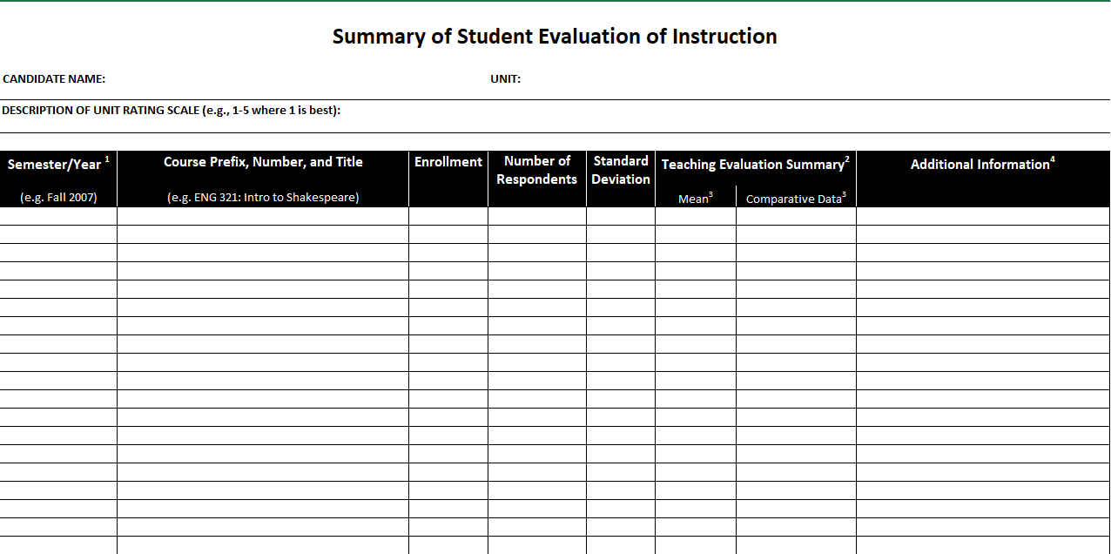
Summary of Student Evaluation of Instruction
Your unit will fill in this information, but you should review it before you sign the Confirmation of Teaching Evidence form.

Slide 30
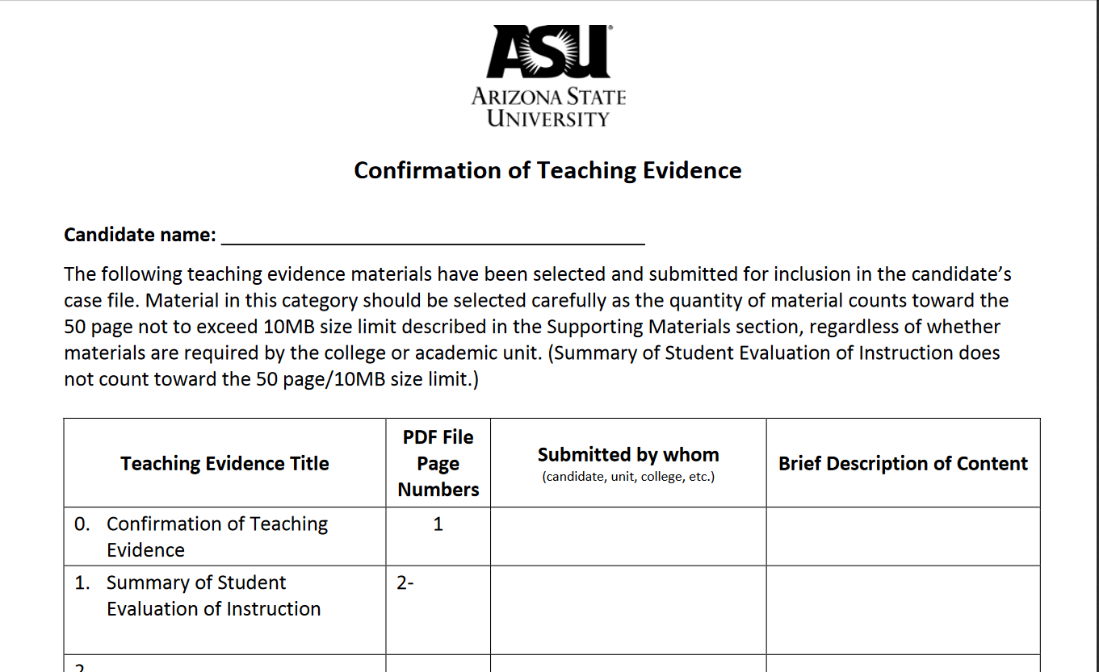
Confirmation of Teaching Evidence
Your unit will fill out this form with your help; review it carefully before you sign.

Slide 31
Teaching evidence
Course evaluations are not always the most accurate way to evaluation teaching excellence. Address any concerns in your personal statement. You might be teaching a required course that everyone hates, for example.

Slide 32
Examples of evidence of student learning
A list of the students who have won prizes.
A list of your students and the jobs they landed.
A list of desired outcomes and how you structured your class to achieve these outcomes.

Slide 33
Process Guide for Promotion of Fixed-term Faculty
Step 1. Submission of materials, continued. e. Supporting materials. If applicable, based on the candidate’s job description, candidate submits electronic (PDF) supporting
materials to unit. Supporting materials may include a total of 50 pages not to exceed 10MB of additional electronic material highlighting excellence in teaching, research, and/or service.
Letters of support from faculty members outside the candidate’s
academic home are included in this section and are not confidential. A faculty member who will review and vote on the candidate should not contribute such a letter.
Pay strict attention to page limits; there is no obligation on the part of the reviewers to read pages beyond the limit.

Slide 34
Process Guide for Promotion of Fixed-term Faculty
Step 1. Submission of materials, continued.
e. Supporting materials, continued. (Note that the materials in item (d) are counted within this page/size limit.) Candidate completes, signs, and submits the Confirmation of Optional Supporting Materials sheet to the unit. The confirmation page
does not count toward the 50-page limit. Indicate on form if there are no materials included in this section. Include citation information as applicable and PDF page numbers on the form.

Slide 35
Tips re optional supplemental materials
Helpful things to include:
Additional letters of support from stakeholders
Documentation on the status of publications and/or grants
Nominations for teaching awards
Published reviews of your work
Unhelpful:
Student comments

Slide 36
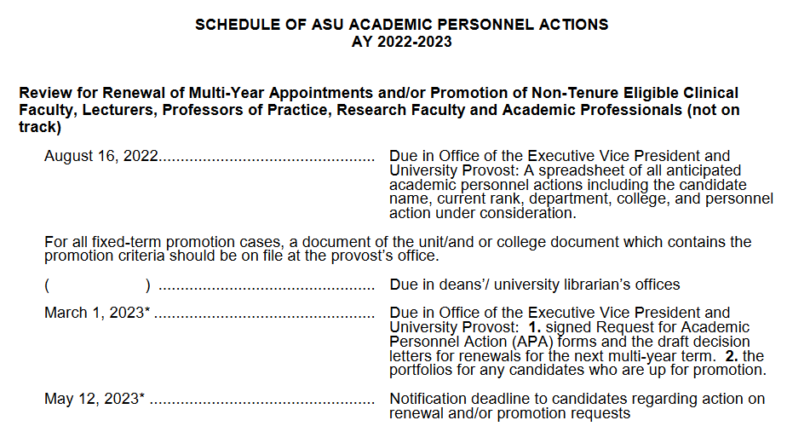
Schedule of Academic Personnel Actions
Faculty members’ deans will receive the provost’s decision by May 12 this year. Academic professionals will receive a letter from the president by May 12 this year.

Slide 37
What if the decision is not to promote?
If you are not promoted, you may go up again in a future year, but it is probably best to wait more than one year so that your materials are significantly different.

Slide 38
Questions?
EK 10-15-21

